Slide 1
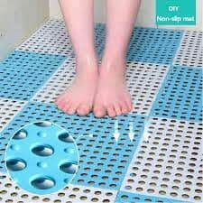
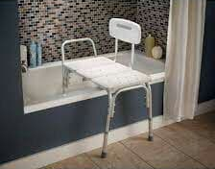
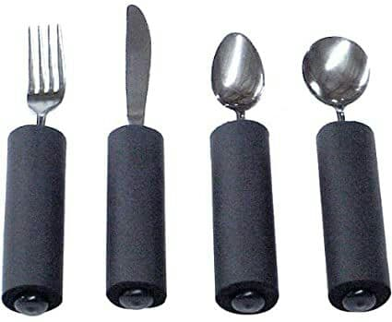
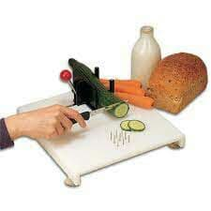
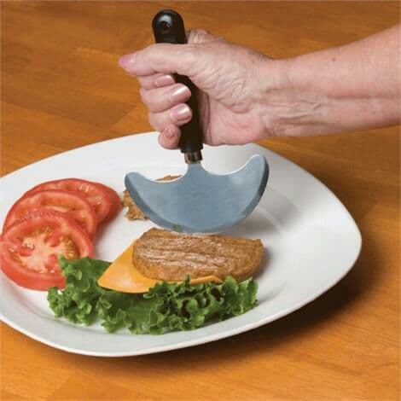
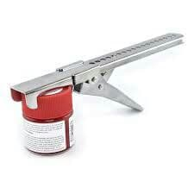
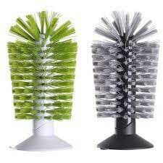
Modifying Home After Stroke
Reza Roozban Ms in Occuptional Therapy
Introduction
Discussion
Home modifications are defined as adaptation applied the physical environment to promote safety and full participation.
Occupational therapists role in environmental modifications at home, work and in community have been shaped by legislation that support the rights of individuals with disabilities and stroke patient to full societal participation depending on the degree of impairment, recovery stage, patient preferences and anticipated discharge environment it may be appropriate to teach compensatory strategies or introduce adaptive equipment during ADL/IADL training.
Stroke survivor by home modification is able to engage in activities of choice in a way that she or he find satisfying and meaningful. Client complete activities with acceptable level of independence, safety, timeliness or efficiency and performance or accuracy.
Method
References
This narrative review article is about modifying the home after stroke. I reviewed the present information as Science direct, PubMed, Google Scholar and other resources from 2005 to 2021.
1. Diane P. Occupational Therapy for Physical Dysfunction, 2021, 1636-1356, 1774-1778.
2. Wolf TJ, Nilsen DM. Occupational Practice Guidelines for Adults with Stroke. Bethesda, MD: AOTA Press; 2015.
Result
Assistive technology and home modification should help make activities of daily living like bathing, getting out of bed, eating, toileting and grooming simple. These home modifications will be most useful for stroke patients experiencing impaired motor control, lack of balance or poor memory.
Devices such as Raised toilet seat, Reacher, Tub or shower seat, Dressing stick, Jar opener, Box toppers, Suction bottle brushes, Adapted cutting board, Nonskid mats, Scoop dishes, Rocker knife, Build up handled utensils, etc. can be used for home modification.
Contact
reza roozban Email: rezaruzban@yahoo.com phone: 09129400829

